Slide 1
ORAU
The University Value Proposition
Steve Roberts, Ph.D.
University Partnerships
Oak Ridge Associated Universities
University of Florida Visit
January 17, 2013

Slide 2
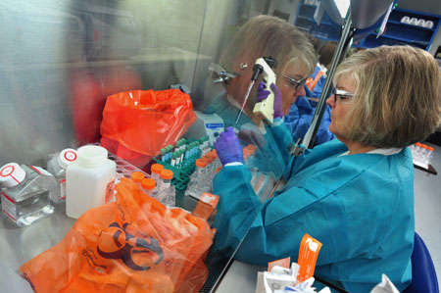

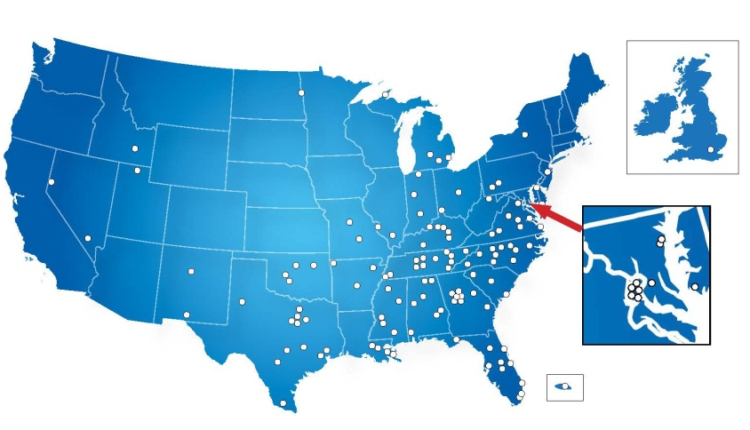
Oak Ridge Associated Universities is a…
. . . Partner with UT-Battelle to expand university collaboration with Oak Ridge National Laboratory
ORAU Member Institutions
. . . Federal contractor managing the Oak Ridge Institute for Science and Education for DOE (ORISE)
. . . University consortium focused on advancing scientific research and education through partnerships
Notes:
We are O-R-A-U and ORAU is 3 things.
We are:
University Consortium (105)
Partner with UT Battelle to expand university collaboration with ORNL – Three areas of ORNL interest: neutrons, computational sciences, climate change
Federal Contractor managing ORISE for DOE and serving many other government agencies
Summary:
ORAU is a Federal contractor that contributes to important national needs in education, worker/public health and environmental stewardship, and national security. We are a non-profit contractor, and we use a portion of the fee generated from these programmatic activities to strengthen our nation’s scientific research and education enterprise through investment in our 105 PhD-granting member universities.

Slide 3
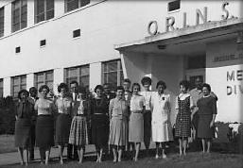
Our beginning as ORINS
Founded in 1946 as Oak Ridge Institute for Nuclear Studies
  Education - research fellowships
  Radiation and nuclear medicine
  Health physics
  Radiation emergency response
14 original member universities
Notes:
Since the days of the Manhattan Project and the Atomic Energy Commission we have been a central component of supporting:
Education and Research
Radiation and Nuclear Medicine Studies
Health Physics and
Radiation Emergency Response

Slide 4
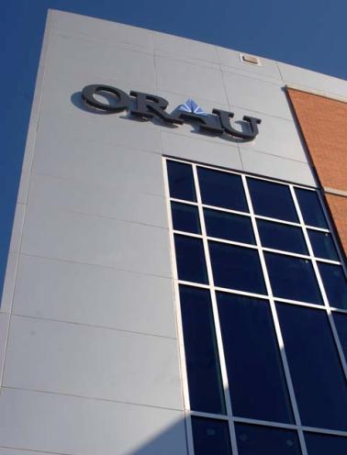
ORAU today
Nonprofit government contractor
Providing scientific, health and security expertise to help our customers:
  Advance research and education
  Protect health and the environment
  Strengthen national security
Notes:
Nonprofit government contractor
Providing scientific, health and security expertise to help our customers:
Accelerate research and education through our services offered in SEP and STRI
Protect health and the environment as we do in HCTT, OEWH and IEAV
Strengthen national security through the work done in NSEM and REAC/TS

Slide 5
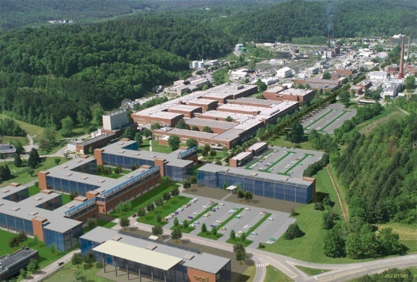
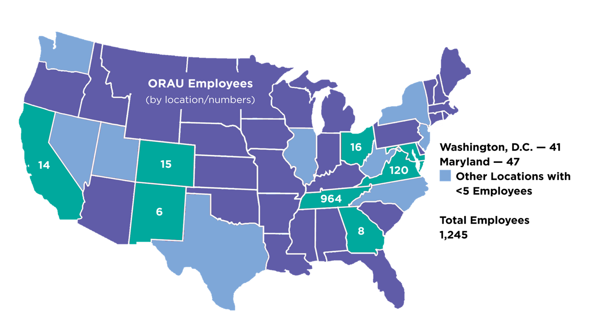
ORAU University Partnership Agenda
ORNL
  Leverage partnership with UT-Battelle
  Help ORNL build mutually beneficial university partnerships
  Primary foci of interest: Neutrons, Computational Science
ORAU
  Expertise to supplement ORAU competencies in large contracts
  Core competency foci: Emergency Response, Forensics, Independent Reviews and Evaluations, Environmental Health, Science Workforce Development, Technical Training
Notes:
Let’s discuss the partnership agenda. ORAU is a strong strategic partner with UT-Battelle at ORNL
ORNL looks to ORAU to identify potential university partners with expertise in areas of interest to the Laboratory. While any science and technology area can be an opportunity target, the primary topics of interest at this time are neutrons, computational science and climate change.
ORAU is not actively pursuing additional university partners. Institutions that provide relevant expertise and share our goals are welcome to apply.
Strong university leadership is important for joint initiatives. The core universities have played a key role in demonstrating that we add value in joint endeavors.

Slide 6

Why university partnerships?
Poised for Joint Proposal Opportunities
Grants & Awards
Funding Opportunities
Relationships
Federal Investment
ORAU Business Lines + University Research Expertise
Notes:
When ORAU partners with universities, we increase our foundation of expertise.
We provide our members with grants and awards, help them with funding opportunities, facilitate relationships and help find opportunities for federal investment.
In turn, with these partnerships ORAU and the universities are better positioned for joint-proposals when contract opportunities arise.

Slide 7
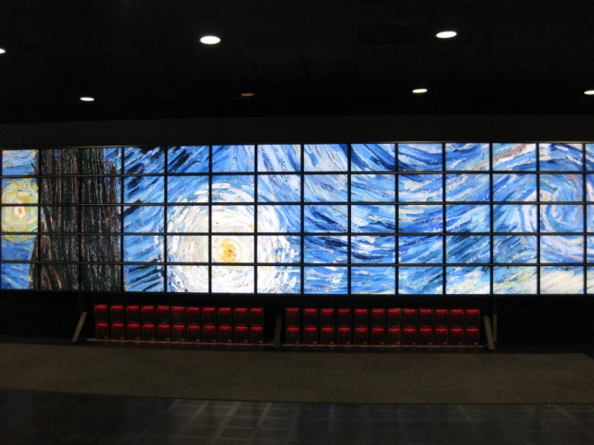
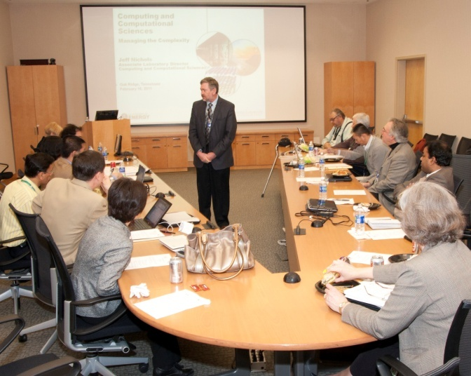
UPO Award Programs
Ralph E. Powe Junior Faculty Awards
  20 year Retrospective study underway
  Deadline January 11, 2013
High Performance Computing Grant Program
  Deadline December 17, 2012
Nobel Laureate – 2013 Program Chemistry
  Deadline December 14, 2012
3 new programs created in FY 11
  Faculty Travel: 9 awards FY 11, 8 awards FY 12
  Event : 8 events FY11, 7 FY 12
  University Technology Testing with ORAU programs: 1 award each in FY11 and FY12
Notes:
The first mission element is the catalytic awards summarized on this slide.
The Powe awards program continued this year with only minor modifications. (Powe- more emphasis on collaboration, started retrospective study.)
Upper photo UT Austin 75 tile visualization using standard model Dell computers, lower photo review of HPC projects.
Students supported by ORAU from members institutions were nominated to participate in the Nobel Laureate program. For 2013, expect to fund 14 students.
Faculty travel awards support collaborations with ORNL or other university partners. Nine awards in FY 11, eight in FY 12 –most support travel to ORNL. In recent years, UPO has provided ad-hoc support for events in response to requests. Now a twice a year competitive process.
Our new funding program to support collaborative testing of technologies developed at universities in partnership with ORAU programs has funded two projects. University faculty can explore the ORAU web site to learn about ORAU program activities.
The popular new programs to support faculty travel, events and transfer of technologies from members to ORAU were initiated this year. Impact will be measured through analysis of reports. It is already apparent that these programs have been effective in increasing awareness of ORAU.

Slide 8

Powe Junior Faculty Award Grants
Early career faculty – competitive selection
111 Applicants from 62 schools in 2012
30 awards @ $5K ORAU, $5K university match
11 Total Winners from UF
Rebecca Butcher, Assistant Professor, Department of Chemistry– FY 2012
Notes:
The Powe awards are a signature ORAU program and have been made for 20 years.
(read slide)
Change this slide to reflect awardees at the institution visited.

Slide 9
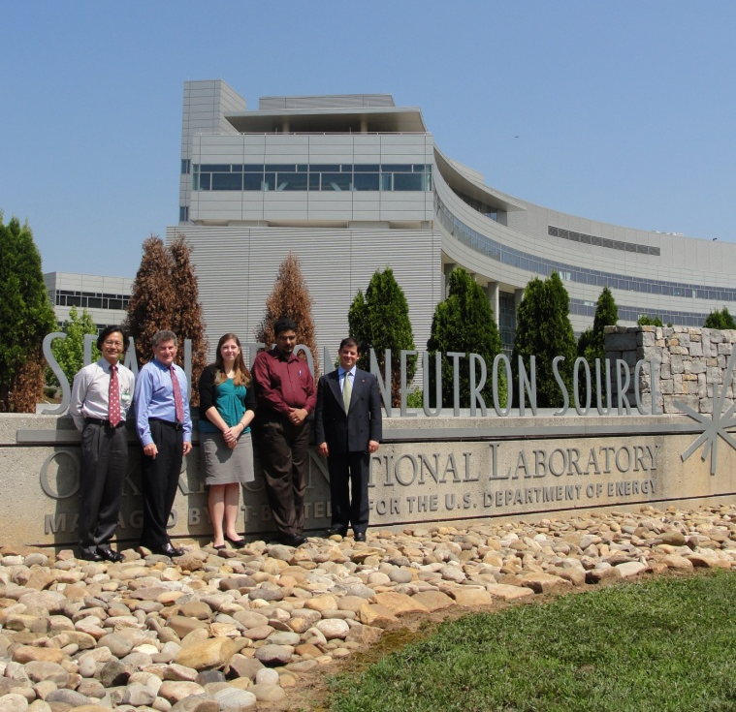
ORNL/ORAU HBCU/MEI Summer Faculty
Faculty summer collaboration at ORNL
Stipend and expenses paid
Approximately 10 awards each summer
FY 2012 awards ORAU institutions
  Fayetteville State University
  Morgan State University
  Southern University and A&M College
  Tennessee State University
  University of Texas at San Antonio
  Virginia State University
Notes:
ORNL and ORAU jointly support opportunities for faculty from HBCUs and MEIs to participate in summer research at ORNL. Each year, one or two of the participants from ORAU institutions are recognized and funded through the University Partnerships Office. For FY 11, 5 HBCU/MEI participants from member universities will be at ORNL (North Carolina A&T State, Southern, University of Texas at San Antonio, and 2 at Virginia State), the one funded by ORAU is Brian Kelley, University of Texas-San Antonio.
Change this slide to reflect awardees at the institution visited.

Slide 10
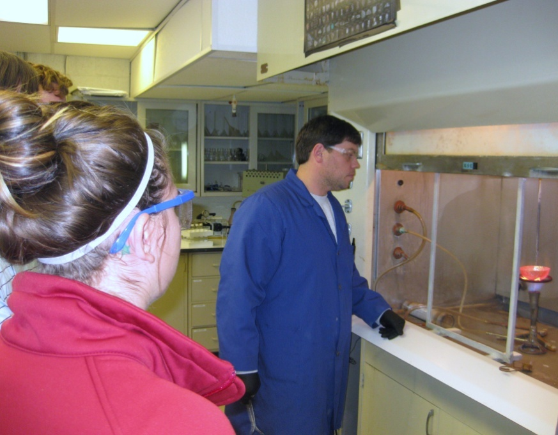
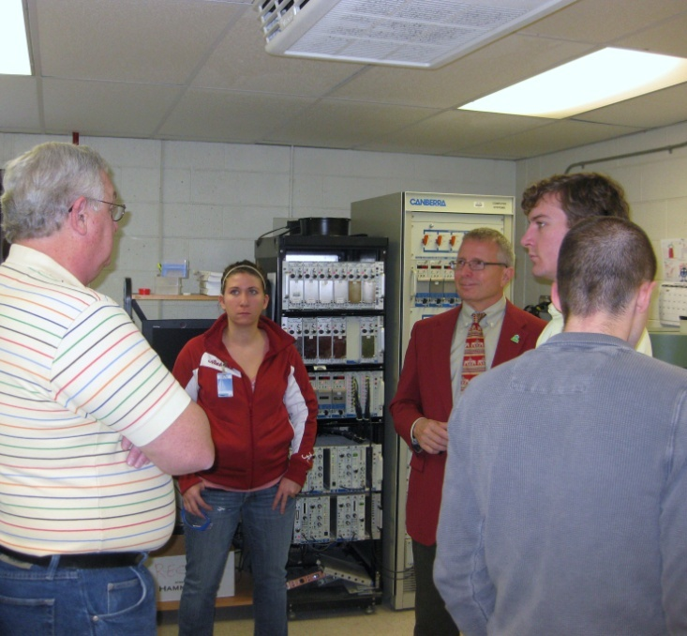
Faculty Travel Awards
Up to $800 to travel to build new collaboration
Can be travel to ORNL or between ORAU institutions
Anticipated outcomes and student engagement are important criteria
Notes:
Proposals for Faculty Travel awards are welcome at any time through the ORAU members only web page. Photos are from the University of Alabama visit, showing a fusion in process and the counting equipment.
Each institution may submit two requests in FY12.

Slide 11


ORAU Event Grants
Up to $4000 for an event involving multiple ORAU institutions
FY 2013
  Workshop on Innovative Approaches to Materials Design
  National Academy of Inventors 2nd Annual Conference
  7th Annual Electric Power Industry Conference
  Finding Consciousness
  Events from April 1, 2013 – Sept. 30, 2013:
  Proposals Due March 1, 2013
Notes:
The new events program has been very popular and has demonstrated significant impact.

Slide 12
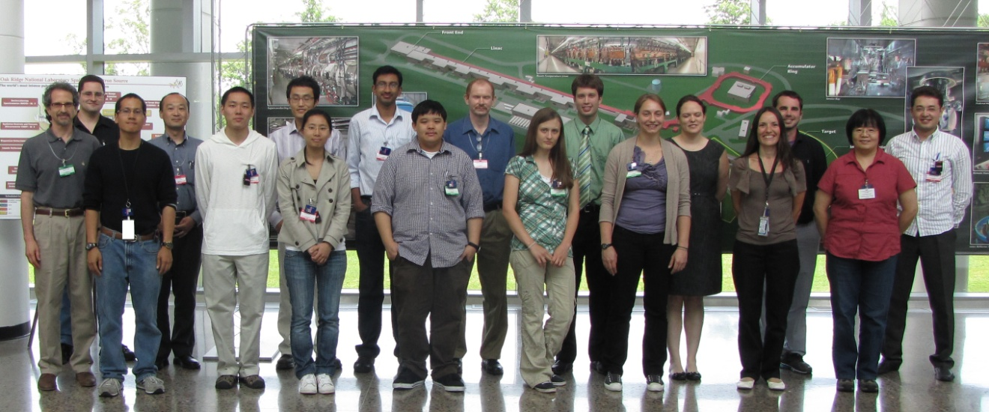
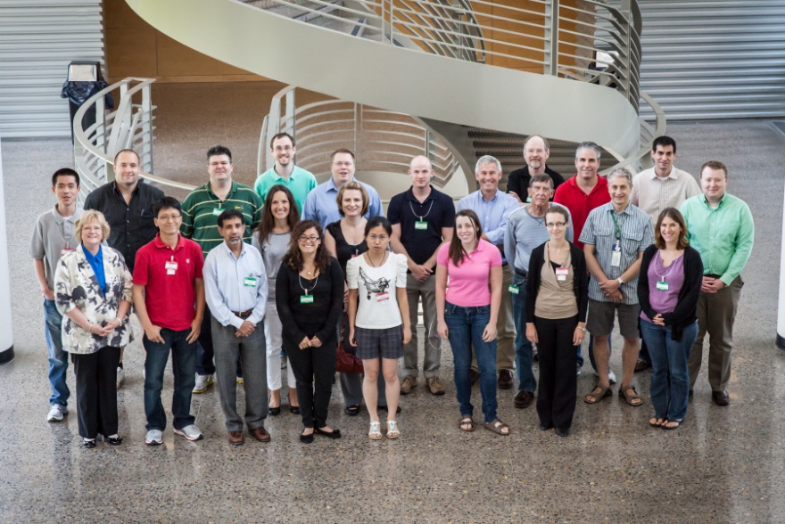
Neutrons in Biology Graduate Course
Graduate students in Structural Biology hands-on experience in neutron crystallography methods
June 7-11, 2010
May 23-27, 2011
June 4-8, 2012
Sponsored by NCSU,
ORAU, ORNL, DOE EPSCoR
15 participants in 2010
14 participants in 2011
15 participants in 2012
Notes:
A new program was instituted last year to build the neutron sciences community by providing classroom and hands-on access to instrumentation for graduate students in structural biology. The class met for a week. All student expenses were paid. Students from ORAU sponsor and associate institutions were funded by the UPO.
Change this slide to reflect participants from the institution visited.

Slide 13
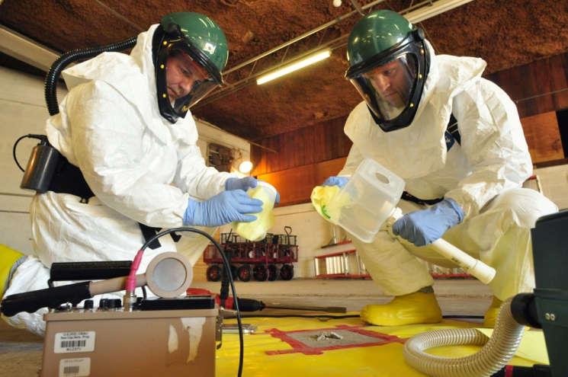
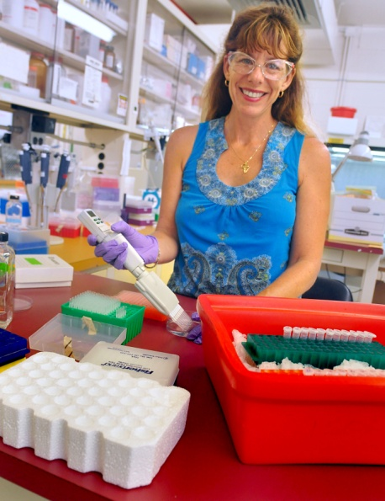
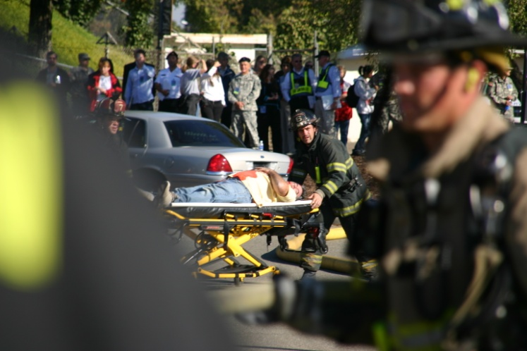
ORAU Manages the Oak Ridge Institute for Science and Education (ORISE) for DOE
Our purpose, our value-based strategy . . .
  strengthen America's scientific
  research and education enterprise
  to enhance global competitiveness
  build public trust and confidence in the management of worker health and environmental
  cleanup initiatives
  enhance our nation’s preparedness to respond to emergencies related to terrorist incidents, natural disasters, and health threats
Notes:
Under our contract to DOE we operate as ORISE.
And ORISE is dedicated to: [ 3 Missions ]
Strengthening America's scientific research and education enterprise
(SEP, University Partnerships, and UNIRIB)
Promoting public trust in the management of worker health and environmental cleanup
(OEWH, HCTT, IEAV)
Enhancing our nation’s response to terrorist and all hazard incidents
(NSEMP, REAC/TS)

Slide 14

Through These ORISE Programs, ORAU Supports the Missions of DOE
Science Education Programs
Scientific and Technical Resource
Integration/Peer Review Programs
Occupational Exposure and Worker Health
Programs
Health Communication and Technical Training
Programs
Independent Environmental Assessment and
Verifications Programs
National Security and Emergency
Management Programs
Notes:
I want to focus on two of these programs that interact extensively with the ORAU universities and provide value. The first is the Peer Review Program. With ORISE Scientific and Technical Peer Review Programs, we are ensuring quality science at all stages of the research review cycle and are instilling confidence in scientific information and funded research.

Slide 15
Through These ORISE Programs, ORAU Supports the Missions of DOE
Science Education Programs
Scientific and Technical Resource
Integration/Peer Review Programs
Occupational Exposure and Worker Health
Programs
Health Communication and Technical Training
Programs
Independent Environmental Assessment and
Verifications Programs
National Security and Emergency
Management Programs
Notes:
All this work is channeled through several programs that support the missions of DOE
(Highlight the first two in following slides. Additional info below.)
ORISE Science Education Programs, we are addressing needs at all levels of STEM education and building tomorrows’ science and technology leaders.
With ORISE Scientific and Technical Peer Review Programs, we are ensuring quality science at all stages of the research review cycle and are instilling confidence in scientific information and funded research.
We are delivering answers to the health concerns of workers and the public . . . and helping improve the quality of lives through expanded health screening capabilities with ORISE Occupational Exposure and Worker Health Programs.
Through ORISE Health Communication and Technical Training Programs we are delivering comprehensive health communications for public health threats . . . from the global to the local level . . . and improving health and safety programs through focused communications and training.
ORISE Independent Environmental Assessment and Verification Programs are synonymous with quality assurance for environmental cleanup. We work to help define the scope of radiological cleanup projects . . . and then ensure the cleanup meet regulatory release criteria.
With a robust ORISE National Security and Emergency Management Program, we are strengthening preparedness and response for terrorism and national emergencies, providing integrated support for national readiness efforts. This program includes ORISE Radiation Emergency Programs which are helping to improve global response to radiation emergencies through continuing medical education leadership and specialized expertise found at the Radiation Emergency Assistance Center and Training Site or REAC/TS.

Slide 16
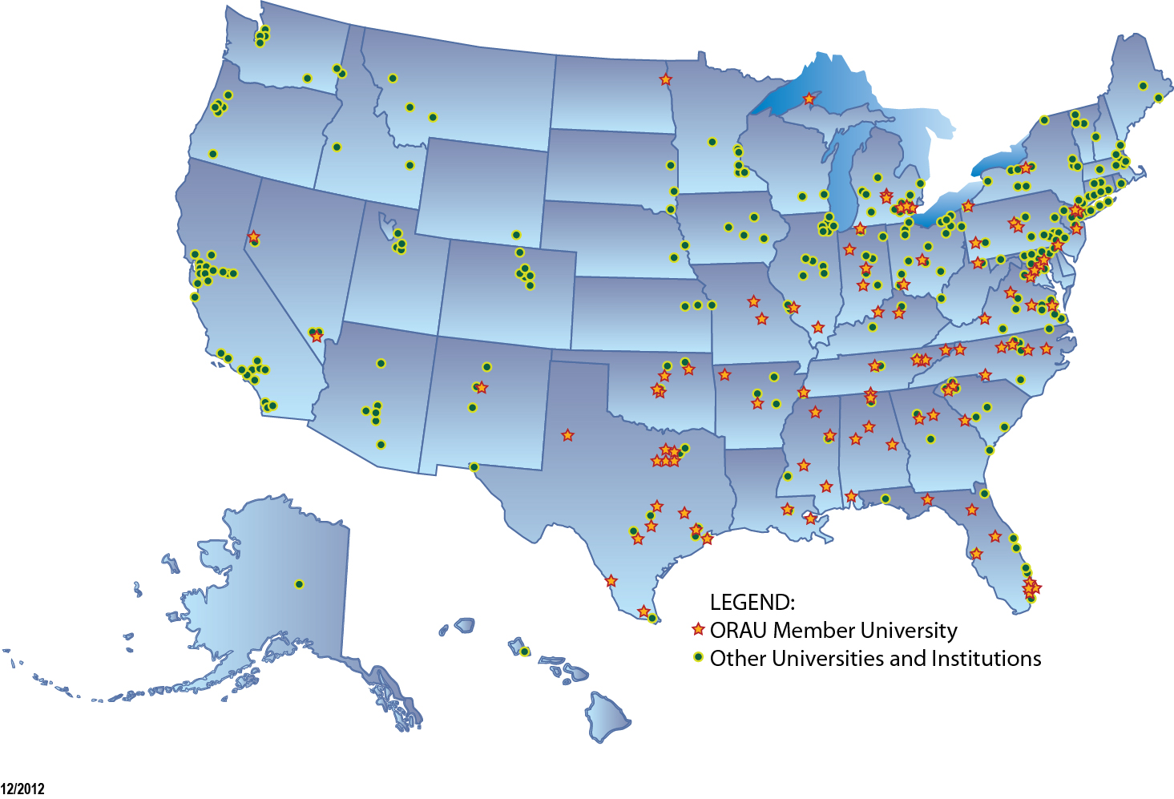
STRI Reviewers from Universities and Colleges, FY 2012
STRI secured a total of 3,759 reviewers, including 772 from 92 member universities.
Note: Five reviewers were from an ORAU member university located in London, UK.
Notes:
In 2012, 817 reviewers from ORAU institutions served as reviewers for the ORAU PeerNet programs.

Slide 17
Through These ORISE Programs, ORAU Supports the Missions of DOE
Science Education Programs
Scientific and Technical Resource
Integration/Peer Review Programs
Occupational Exposure and Worker Health
Programs
Health Communication and Technical Training
Programs
Independent Environmental Assessment and
Verifications Programs
National Security and Emergency
Management Programs
Notes:
Another ORAU program that provides major benefits to the sponsoring and associate universities is the Science Education Programs, or SEP.

Slide 18



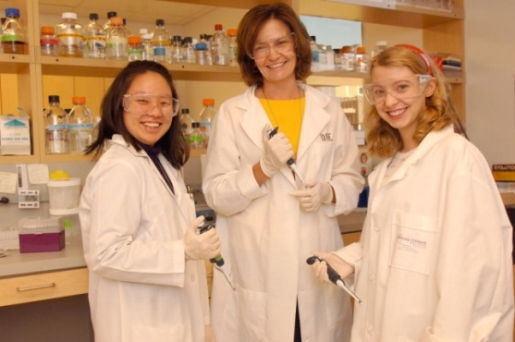
Filling the Pipeline of Future Science and Technology Leaders
ORAU’s contribution:
  Experience-based programs tailored to measurable outcomes
  Scholarship, fellowship, internship, postgraduate, postdoc, K-12, and senior scientist programs
  >8000 faculty and students annually 1,000 colleges and universities $196M sponsored by 14 federal agencies over 200 research institutions
Major programs:
  UT-Battelle/ORNL science education partnership
  DOE scholarship, fellowship, internship programs
  NASA postdoctoral associates
  DHS scholars and fellows program
  DHHS (FDA, CDC, NIH) undergraduate, graduate, postdoc programs
Notes:
Science education at all levels is the focus of many ORAU programs managed outside UPO. Here are a few examples of how we are contributing to advancing scientific research and education to increase America's competitiveness:
Programs that have meaningful impact across the entire educational system
More than 8,000 faculty and students these students are coming from more than 1,000 different colleges and universities
In FY 12 this program involved $196 million -- coming from numerous different federal agencies

Slide 19
Filling the Pipeline of Future Science and Technology Leaders – ORAU Touches All Levels
In FY12, ORAU/ORISE Programs Involved more than 8,384 Participants
Undergraduates
Graduate Students
Recent Graduates
(M.S., B.S., 2-year)
Postdoctoral Fellows
College/University Faculty
K-12 Students and Teachers
Other Scientists &
Professionals
1181
980
1673
1678
279
2146
447
Notes:
In terms of supplying American’s need for advanced science and education -- we fill the pipeline at every level . . .

Slide 20
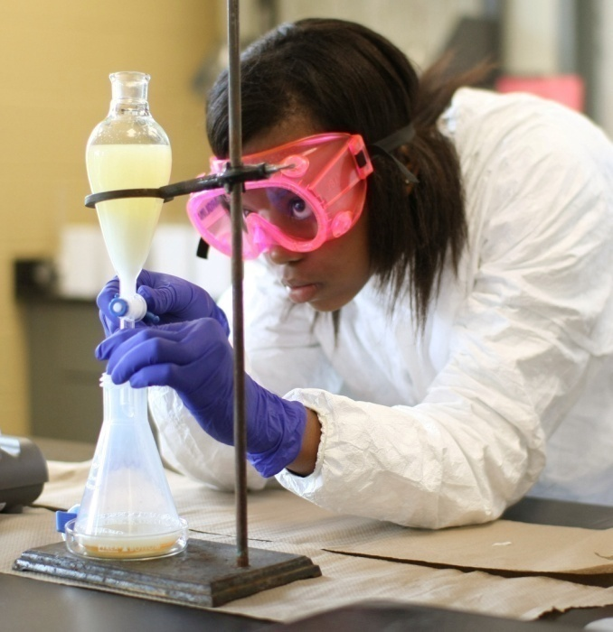
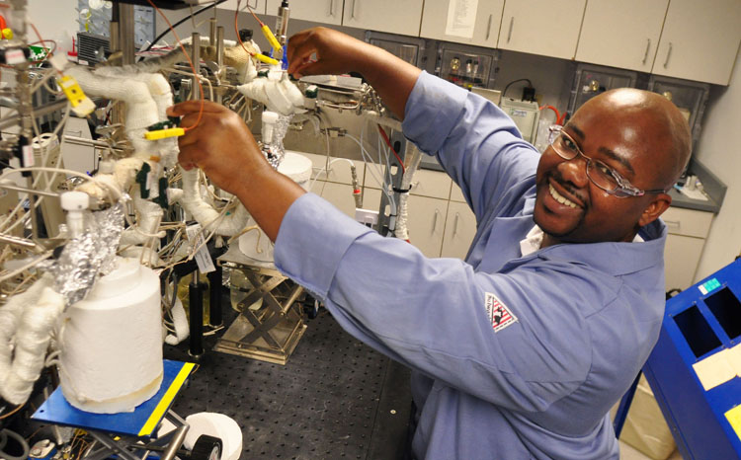
Increasing Minority Representation in Science and Engineering Degree Programs
Minority Participation
14.7%
Undergraduates
Graduate Students
Recent B.S. and
M.S. Graduates
Recent Ph.D.
Graduates
14.7%
10.7%
15.9%
14.2%
15.7%
7.8%
13.3%
National Average
ORISE Programs
Notes:
Minority representation matters to us and to our sponsors, so we set challenging goals in this area.
The blue bars on the graphs show the percentages of underrepresented students in science, math, engineering, and technology fields that are currently enrolled in US colleges and universities at those academic levels. The red bars show the percentages of these students in ORAU’s programs. So you can see that our programs consistently exceed the percentages of underrepresented students who are enrolled in US universities.

Slide 21
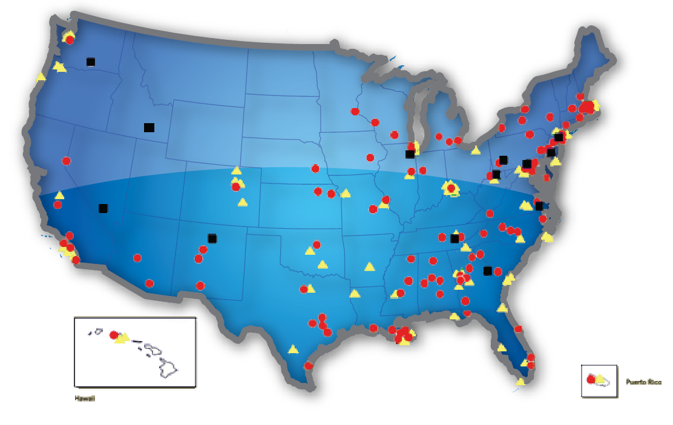
National Laboratories, Federal Research Centers, and Universities Host Participants
Selected Program Sponsors:
Oak Ridge National Laboratory
Centers for Disease Control
Department of Commerce
Department of Defense
Department of Energy
Department of Homeland Security
Environmental Protection Agency
Federal Bureau of Investigation
Food and Drug Administration
National Aeronautics and Space Administration
National Institutes of Health
National Science Foundation
Nuclear Regulatory Commission
2011
Academic Institutions
DOE Complex Facilities
Other Research and Technology Facilities
Notes:
We work with about 14 federal agencies, institutes and offices.
[Note: Wayne typically says “about 12 federal agencies” because some are really parts of others and ORNL isn’t an agency, but the wording above clarified the variance in numbers.]
Some participating offices not listed here include:
CDC’s Agency for Toxic Substances and Disease Registry
NIH’s National Library of Medicine
[NOTE: NOAA has been removed from the list because their program is ending.]

Slide 22
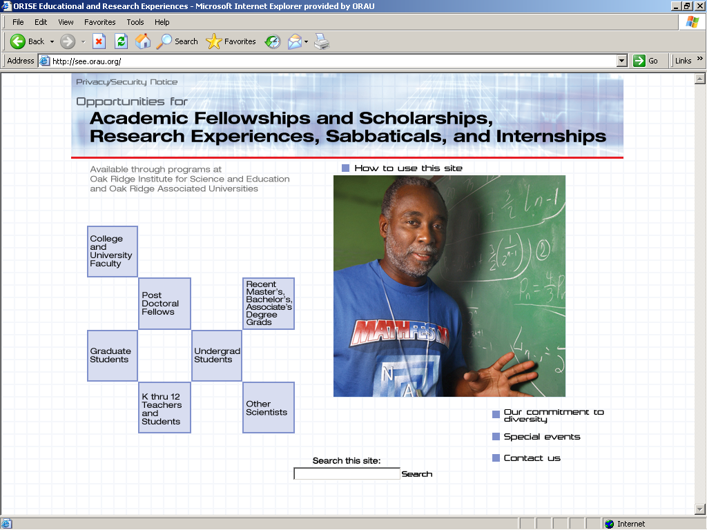


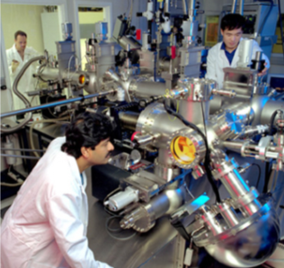
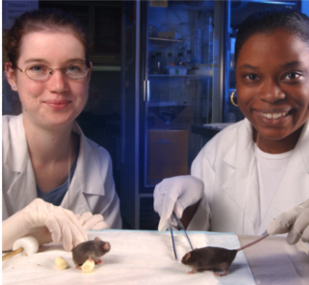
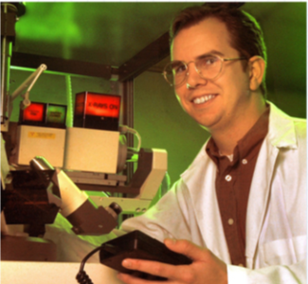



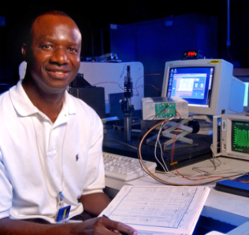
Detailed Information is Available on Each Program Operated by ORAU
http://see.orau.org

Slide 23

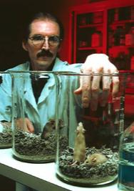
ORAU University Partners Participate in Science Education and Research Programs, FY 2012
ORAU/ORISE administered programs -$196M total all schools
  ORAU institutions
    Fellowship and Scholarship – 52 participants $1.9M
    Internships, Research and Travel Programs, Workshops – 2,412 participants $70M
  UF $1,902,300
  1 Faculty, 8 Grad. Students,
  27 Postdocs, 9 Post-Grad Interns,
  2 Undergrads
Notes:
These statistics illustrate of the value to institutions that are associated with ORAU. SEP programs supported faculty and students with $196M in stipends/participant costs, of which about $72 M was received by ORAU sponsoring and associate universities. This breaks down into about $2 M in fellowships and scholarships and almost $70M in internships and other programs. The UPO program administers an additional $ 500K in programs limited to ORAU institutions, which I described earlier.

Slide 24
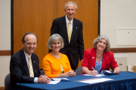
Moving Forward
Actively pursing joint proposals
  ORAU plus universities
  ORNL with universities
  Facilitating collaborative proposals between universities
Negotiating MOUs with member universities
Funds available to assist with technology field testing
  University devices used by ORAU program
  ORAU provides testing location, standard measurements
  Jointly pursue additional funding

Slide 25

Annual Council Meeting, March 6-7, 2013
From Campus to Corporate
  The University Innovation Ecosystem
  The Evolving University Research Park
  Open Innovation

Slide 26

We are Making a Difference –
We are ORAU!
Notes:
As you can see, O-R-A-U is a strong team and we’re making a difference.
We’re bringing the collective power of our employees . . . and their knowledge, skills and commitment to excellence . . . to help strengthen America’s education enterprise and . . . to help our country compete on a global scale.
Thank you.

Slide 27
Thank you.
GO VOLS

Slide 28
Extra Slides
Notes:
Add slides after this as appropriate for specific talks

Slide 29
MOUs August 2012
Emory
Florida
FL Institute of Technology
Florida International
Florida State
George Mason
Georgia
Georgia Tech
Indiana
Jackson State
Lincoln Memorial
Louisville
Maryland
Memphis
Michigan Tech
Mississippi State
Morgan State
New Orleans
North Texas
Notre Dame
Oklahoma
Oklahoma State
Penn State
South Carolina
South Florida
Southern Illinois
Southern U A&M
Tennessee
TN Tech
Texas, Arlington
Texas, Austin
Texas, Pan American
Texas, San Antonio
Texas Tech
Tulane
Tulsa
Utah State
Virginia Commonwealth
Virginia Tech
Wayne State
West Virginia
William and Mary
All Institutions Contacted
Finalized
MOUs = 53
Alabama, Birmingham
Alabama, Huntsville
Alabama, Tuscaloosa
Arkansas
Auburn
Central Florida
Clemson
Charleston
Delaware
East Carolina
Embry-Riddle
Notes:
MOUs are essential before we can share proprietary information and participate in joint proposals. Since January we have been working with Business Development to sign MOUs with member institutions. This was discussed at the March Council meeting and negotiations are underway with all members who requested information. Fourty eight have been signed as of June 2012. ORAU has agreed to alternative language in all cases, and the majority of the others in process are awaiting university response.
We are now considering creation of a special location to communicate opportunities with institutions that have signed MOUs. This will likely be an external SharePoint site or using a tool developed by a local small business.

Slide 30
National Security and Emergency
Management Programs (NSEMP)
Program Facts
  NSEMP provides emergency response readiness support to Federal and State Agencies tasked with a counter terrorism or homeland security mission.
    “Detect, Deter & Defeat Terrorism” – Response to Natural Disasters or Man-made Accidents
  226 employees
    Education range from BS to MD – recent graduates to those with 40+ years of experience in emergency response
  $45 million in revenue – FY 2010
Primary Customers
  Federal: NNSA-DOE, FBI, DNDO, FEMA, and DOS
  State: California Office of Emergency Mgmt
Notes:
Integrated Capabilities
Exercises Development and Implementation
Training
Management Support
Policy Implementation Support
Technology Solutions
Technical Expertise
Operational Assistance
Medical Expertise
International Support

Slide 31
NSEMP Needs
Needs that University Partners might be able to address
Staffing needs
  Public Health/Emergency Management /Forensics
Proposal partnership opportunities
  Technology development – Radiological Detection and Forensics
  National Technical Nuclear Forensics
Technical solutions:
  Vacant towns, infrastructure, and maritime assets for exercises and training events
  Infrastructure vulnerability assessments related to WMD/Radiological response
  Regionalized training facilities (FEMA-PRND, DOE-RAP, REAC/TS, etc.)

Slide 32
Scientific and Technical Resource Integration/Peer Review Programs (STRI/PRP)
Program Facts
  Primary objective: Support federal grant award and program evaluations through independent peer review.
    Risk management – conflict of interest, process integrity
    Meeting logistics – Web tools, schedule
    Academic engagement – 6,277 participants
  Number of Staff and Scope of Talent: 70 staff, mostly specialized project management, meeting support, and peer review process experts
  Business volume: $19M (FY-10), more than $1.6B in grant funding reviewed
  Primary Customers: Department of Energy (Office of Science and Energy Efficiency and Renewable Energy), Department of Homeland Security (Science and Technology, University Partnerships Office), and Pennsylvania (Office of Health)
Notes:
93 Reviews
67 Workshops
6,277 Participants

Slide 33
STRI Needs
Needs that University Partners might be able to address
  Staffing needs: We need reviewers! Always recruiting reviewers. Broad array of technical fields. Use Scholar Universe and referral from ORAU University Partnerships. Also need screeners.
  Proposal partnership opportunities: Interested in broad teaming arrangements that will make faculty available for short-term technical and evaluation projects. I want to learn how blue-ribbon panels, policy analysis, and technical boards function.
  Technical solutions: Industry trend in peer reviews is toward less labor-intensive, more Web-enabled solutions.

Slide 34
Independent Environmental Assessment and Verifications Programs (IEAV)
Program Facts
  Our Critical Missions are to:
    Strengthen public trust and confidence in environmental management programs by performing independent characterization and verification of the cleanup of contaminated sites
    Provide specialized health physics technical services and training
    Research to advance understanding in air quality, climate change, and atmospheric contaminants’ transport and deposition
  Our team of 74 highly skilled individuals have diverse backgrounds in Health Physics, Environmental Sciences, Quality Assurance, and Atmospheric Research
  In 2010 total revenues ~ $17 million
  Our primary customers include the Department of Energy Office of Environmental Management, the Nuclear Regulatory Commission, and the National Oceanic and Atmospheric Administration

Slide 35
IEAV Needs
Needs that University Partners might be able to address
  Staffing needs
    Environmental expertise such as hydrogeology, industrial hygiene, contaminant transport, and risk assessment
    Specialized training in radiological sciences (e.g., radiochemistry, radioecology, radiobiology, environmental risk assessment)
  Proposal partnership opportunities
    Use of university training facilities and instructors to expand locations for course offerings
    Environmental engineering expertise to perform contaminant fate and transport studies
  Technical solutions
    Specialized field contaminant detection systems (e.g., long-range alpha detectors, portable laboratory equipment)
    Secure web-based communications tools

Slide 36
Health Communication and Technical Training Programs (HCTT)
Program Facts
  Primary objective: Improve the health and safety of the public and workers through 1) creating customized health communication and learning solutions to control disease and promote healthy behaviors 2) developing occupational health and safety training
  Number of Staff and Scope of Talent: 85 staff with degrees in public health, other health sciences, communication, and instructional design.
  Business volume: annual expenditures of $15M
  Primary Customers: CDC, NIH, DOE

Slide 37
HCTT Needs
Needs that University Partners might be able to address
  Staffing needs: expertise in applying behavioral models for changing health related lifestyle choices of target audiences public communication experts occupational health & safety experts
  Proposal partnership opportunities?
  Technical solutions: development of social media and other electronic tools to reach target audiences e.g. smart phones, I-pads, virtual reality learning tools

Slide 38
Occupational Exposure and Worker Health
Programs (OEWH)
Program Facts
  Primary objective is to offer a comprehensive approach to helping clients customize their worker health solutions by providing innovative solutions to their worker health needs
  81 employees with expertise in Epidemiology, Information Management, Biostatistics, Health Physics, Industrial Hygiene, Laboratory Technology, Medical Coding, Public Health and Occupational Medicine.
  Fiscal Year 2010 expenditures were $46.8 million
  Primary customers include:
    U.S. Department of Energy
    U.S. Nuclear Regulatory Commission
    National Institute for Occupational Safety and Health

Slide 39
OEWH Needs
Needs that University Partners might be able to address
  Future need for physicians/mid-level providers with interest or expertise in occupational health, need for graduates of industrial hygiene programs, need for graduate level statisticians/biostatisticians (internships and recent graduates)
  Possible partnerships may include work utilizing physicians with certain specialties or subject matter experts outside our current capabilities
  Partnering with research institutions with Subject Matter Experts in the fields of:
    Radiation Epidemiology and Health Physics
    Biostatistics
    Human Health Effects of the Exposure to Nanomaterials
    Immunology
    Information Management

